Slide 1
Statistical Inference An Introduction

Slide 2
Contents
Basic Terms as Prerequisite
What is Statistical Inference
Parameter, Estimator, Estimate
Point Estimation
Interval Estimation
Sampling distribution and Sampling error
Hypothesis testing
Two types of errors
One tailed and two tailed tests
How to decide H0 and H1

Slide 3
Basic Terms as Prerequisite
Variable (under study) – What you measure (ex. monthly salary of employees)
Population- Set of all units in the study (all employees in the organization)
Sample- Subset of units selected from population (ex. monthly salary of few selected employees in the organization)
Distribution-How values of variable are distributed in the population (ex. normal distribution)
Factor- Defines subgroups in the study.(ex. Gender, where gender wise salary distribution can be studied.)
Descriptive Statistics- mean, median, standard deviation etc of the variable under study.. (ex. Average salary)

Slide 4
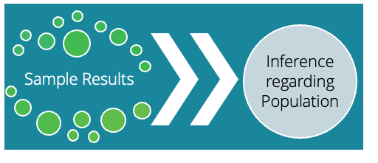
What is Statistical Inference ?
Statistical inference is the process of drawing conclusion about unknown population properties, using a sample drawn from the population.
These unknown population properties can be:
- Mean
- Proportion
- Variance etc.
Such unknown population properties are called as ‘Parameters’.

Slide 5
What is Statistical Inference ?
Statistical Inference
Estimation
Point estimation
Interval estimation
Testing of Hypothesis
Summarize the sample by a single value as an estimate of the population parameter.
Ex. Average salary of junior data scientists is. 55,000 euros.
A range of values within which, we believe,
the true population parameter lies with high probability.
Ex. Average salary of junior data scientists is in the range of (52,000,55,000)
With 95% confidence level.
To decide whether a statement regarding population parameter is true or false, based on sample data.
Ex. Claim: Average salary of junior data scientists is greater than.50,000 euros annually.

Slide 6
Parameter, Estimator, Estimate
Parameter: Unknown property or characteristic of population
- (population mean (µ), variance (𝞂²), proportion (P))
Estimator: A rule or function based on sample observations which is used to estimate the parameter
- (sample mean, sample variance, sample proportion)
Estimate: A particular value computed by substituting the sample observations into an Estimator.

Slide 7
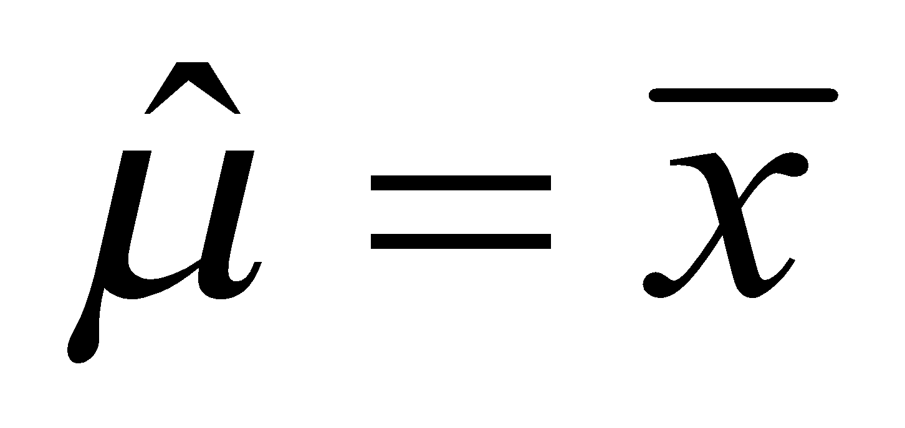
Parameter, Estimator, Estimate
Research Question: What is the average salary of junior data scientists in Europe?
- Average salary of junior data scientists in Europe is Population Parameter.
- Sample of 250 junior data scientists is observed and Sample mean is computed.
- Sample mean is used as Estimator of Population Mean.
- Sample mean “55,000” which is calculated from sample of 250 is the Estimate.
Average salary of junior data scientists (μ)
Unknown population Parameter
Estimator
Estimate based on n=250
euro 55,000

Slide 8
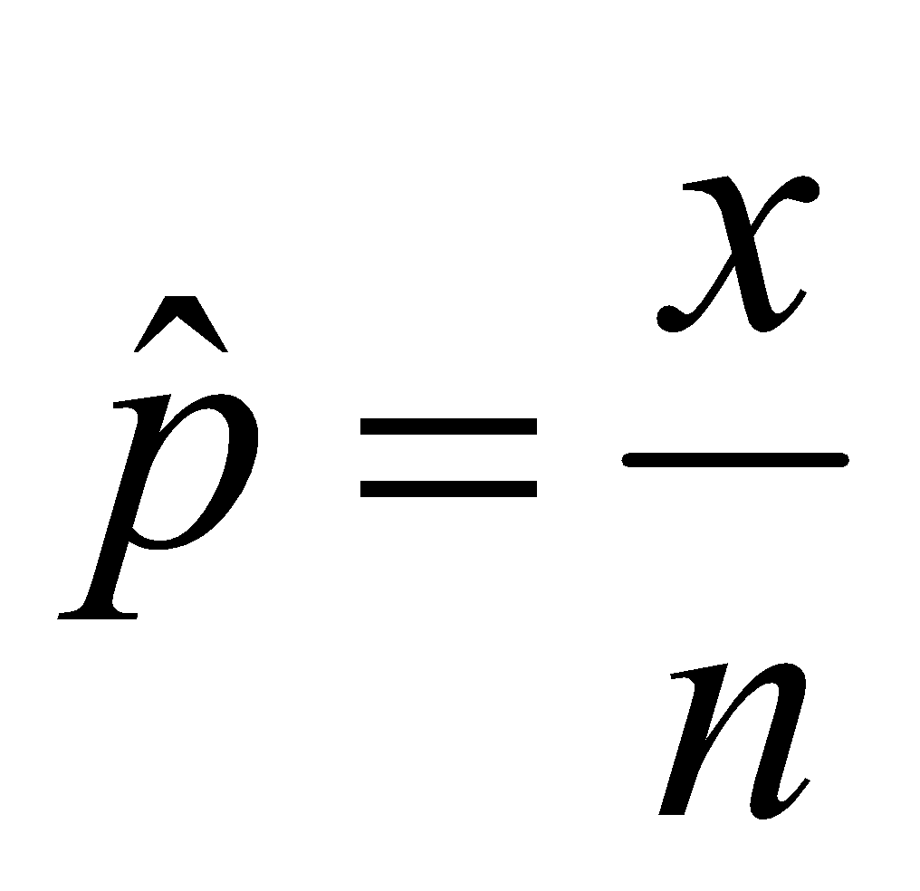
Parameter, Estimator, Estimate
Research Question: What is the proportion of data scientists in Europe who use R for data analysis?
- Proportion of data scientists in Europe who use R for data analysis is population parameter.
- Sample of 430 data scientists observed and proportion (or percentage) is calculated.
- Sample proportion is used as an estimator of population proportion.
- 380 out of 430 which is calculated from sample is Estimate.
Proportion of data scientists in Europe using R
Parameter
Estimator
Estimate based on n=430
380 out of 430=0.8837

Slide 9
Point Estimation vs. Interval Estimation
In both the previous examples, (estimation of average salary of junior data scientists and proportion of data scientists using R) estimator is a single value estimating unknown population parameter.
A confidence interval gives an estimated range of values which is likely to include an unknown population parameter with some probability, the estimated range being calculated from a given set of sample data.
Generally, 95% or 90% Confidence Intervals are used.
95% confidence interval is a range estimate within which the true value of the parameter lies with probability 0.95.

Slide 10
Sampling distribution and Sampling error
Research Question: What is the average salary of junior data scientists in Europe?
- 50 samples, each of size 250 junior data scientists are observed and sample mean for
each of theses 50 samples are computed. Here, sample mean will vary based on sample values.
A probability distribution of all these means of the sample is called the sampling distribution of mean.
Standard error is standard deviation of the these mean values.

Slide 11
Hypothesis Testing
Hypothesis: An assertion about the distribution / parameter of the distribution of one or more random variables.
Null Hypothesis (H0): An assertion which is generally believed to be true until researcher rejects it with evidence.
Alternative Hypothesis (H1): A researcher’s claim which contradicts null hypothesis.
In simple words, testing of hypothesis is to decide whether a statement regarding population parameter is true or false, based on sample data.
Test Statistic: The statistic on which decision rule of rejection of null hypothesis is defined.
Critical region or Rejection region: the region, in which, if the value of test statistic falls, the null hypothesis is rejected.

Slide 12
Hypothesis Testing : Example
Objective | A consumer protection agency wants to test a Paint Manufacturer’s claim, that average drying time of their new paint is less than 20 minutes.
Sample: n=36 boards were painted from 36 different cans and the drying time was observed.
Estimator of mean drying time is sample mean
Null Hypothesis (H₀): µ = 20
Alternate Hypothesis (H₁): µ < 20
Test Statistic | In this case the test statistic is based on
Decision Criteria | Reject null hypothesis if test statistic based on sample mean is less than critical value.

Slide 13
Two types of error
While testing the hypothesis using any decision rule, one of the following scenario might occur.
For example, in legal system,
H0: person is not guilty H1: person is guilty
Decision | Reality
 | Ho is true | Ho is false
Reject Ho | Type I error | Correct
Do Not Reject Ho | Correct | Type II error
Decision | Reality
 | Not Guilty | Guilty
Guilty | Type I Error -- Innocent person goes to jail | Correct
Not Guilty | Correct | Type II error Guilty person is set free

Slide 14
Two Types of error
Level of significance (LOS): Probability of Type I error is called as ‘Level of Significance (α)’
generally set as 5% (los=0.05) and null hypothesis is rejected if observed risk(p value) is less
than 0.05
p-value: is the smallest level of significance that would lead to rejection of the null hypothesis (generally if p <0.05, we reject the null hypothesis).
α = Probability [Type I Error] = Probability [Reject H0 | H0 is True]
β = Probability [Type II Error] = Probability [Do not reject H0 | H0 is not True]
Power of the test is given by: (1 – β)

Slide 15
One tailed and two tailed tests
Hypothesis test where the alternative hypothesis is one-tailed (right-tailed or left-tailed), is called a one-tailed test.
H0: µ = µ0
H1: µ > µ0 (Right-tailed) or H1: µ < µ0 (left-tailed)
Hypothesis test where the alternative hypothesis is two-tailed is called two-tailed test.
H0: µ = µ0
H1: µ ≠ µ0

Slide 16
Quick Recap
Statistical Inference
It is the process of drawing conclusion about unknown population properties, using a sample drawn from the population.
Point Estimation
Summarize the sample by a single value as an estimate of the population parameter.
Interval Estimation
A range of values within which, we believe, the true population parameter lies with high probability.
Testing of Hypothesis
To decide whether a statement regarding population parameter is true or false
Type I error
α = Probability [Type I Error] = Probability [Reject H0 | H0 is True]
Type II error
β = Probability [Type II Error] = Probability [Do not reject H0 | H0 is not True]
Power of the test is given by: (1 – β)

